Slide 1
Flip-Flop Types
SR Flip flop (Set Reset FF)
JK Flip Flop (Jack Kilby FF)
D Flip Flop (Data or transparent FF)
T flip flop (Toggle FF)

Slide 2
Today’s Highlights
Flip Flop v/s Latch
SR Flip Flop
D Flip Flop

Slide 3
Flip Flop and Latches Comparison
Lets Do Flip Flop in detail…
Latch | Flip flop
Level sensitive | Edge sensitive
A latch doesn’t contain any clock signal | A flip-flop contains a clock signal
The structure of Latches is built with logic gates | FFs are designed with latches by adding an extra clock signal.
Latches are responsive toward faults on enable pin | FFs are protected toward faults
Asynchronous | Synchronous
Faster | Slower

Slide 4
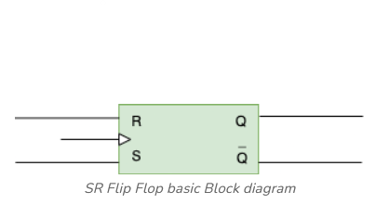
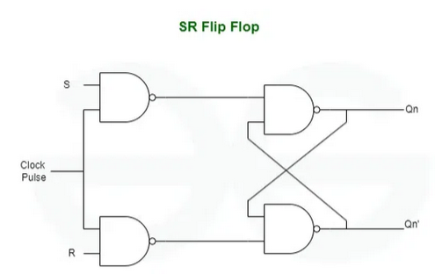


SR Flip
Step 1: Block Diagram
Step 2: Circuit diagram Diagram

Slide 5
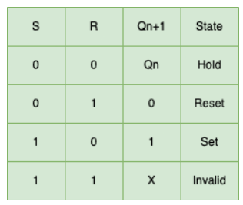
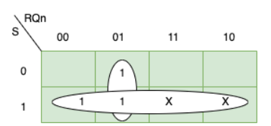

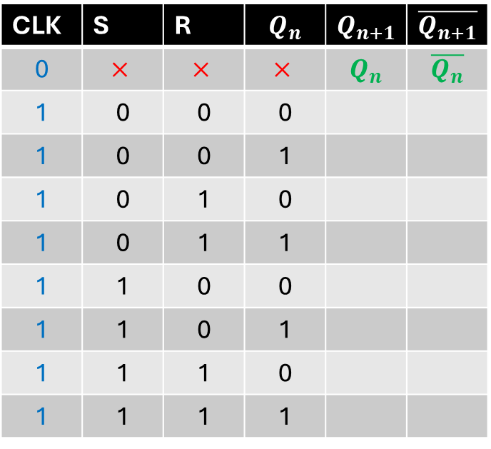
Step 3: Truth Table
Step 4: Characteristics Table
CLK | S | R | $$Q_{n}$$ | $$Q_{n+1}$$ | $$\overline{Q_{n+1}}$$
0 | $$×$$ | $$×$$ | $$×$$ | $$Q_{n}$$ | $$\overline{Q_{n}}$$
1 | 0 | 0 | 0
1 | 0 | 0 | 1
1 | 0 | 1 | 0
1 | 0 | 1 | 1
1 | 1 | 0 | 0
1 | 1 | 0 | 1
1 | 1 | 1 | 0
1 | 1 | 1 | 1
Step 6: Characteristics Equation

Slide 6
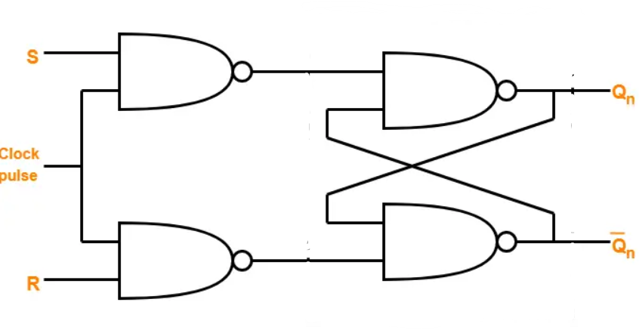
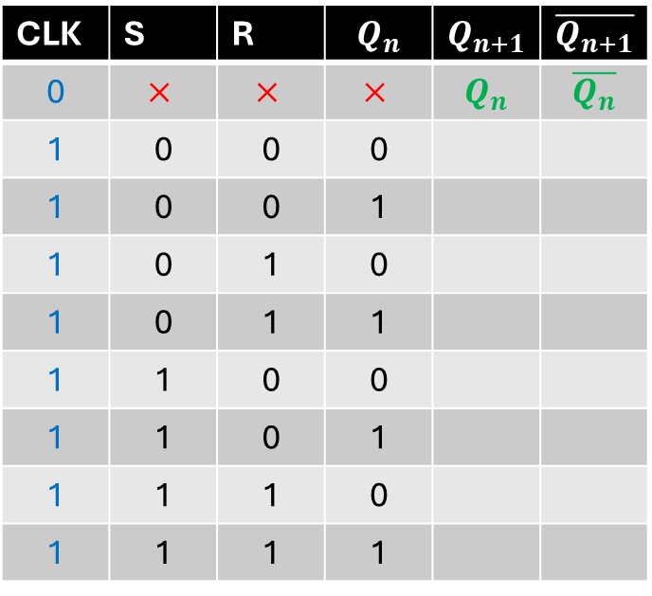
Case1: S=0, R=0
Case2: S=0, R=1
CLK | S | R | $$Q_{n}$$ | $$Q_{n+1}$$ | $$\overline{Q_{n+1}}$$
0 | $$×$$ | $$×$$ | $$×$$ | $$Q_{n}$$ | $$\overline{Q_{n}}$$
1 | 0 | 0 | 0
1 | 0 | 0 | 1
1 | 0 | 1 | 0
1 | 0 | 1 | 1
1 | 1 | 0 | 0
1 | 1 | 0 | 1
1 | 1 | 1 | 0
1 | 1 | 1 | 1
Case4: S=0, R=0
Case3: S=1, R=0

Slide 7
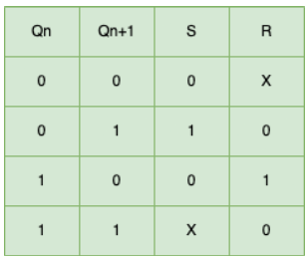
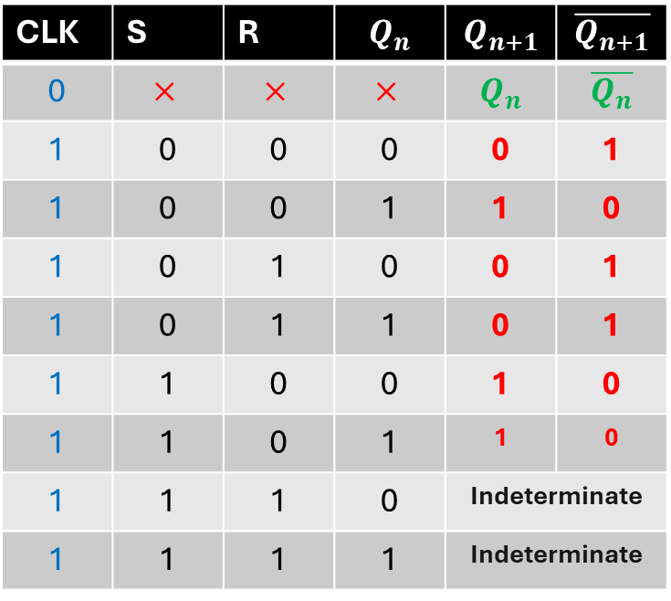
Complete Characteristics Table
Step 5: Excitation Table
CLK | S | R | $$Q_{n}$$ | $$Q_{n+1}$$ | $$\overline{Q_{n+1}}$$
0 | $$×$$ | $$×$$ | $$×$$ | $$Q_{n}$$ | $$\overline{Q_{n}}$$
1 | 0 | 0 | 0 | 0 | 1
1 | 0 | 0 | 1 | 1 | 0
1 | 0 | 1 | 0 | 0 | 1
1 | 0 | 1 | 1 | 0 | 1
1 | 1 | 0 | 0 | 1 | 0
1 | 1 | 0 | 1 | 1 | 0
1 | 1 | 1 | 0 | Indeterminate
1 | 1 | 1 | 1 | Indeterminate
Step 6: Characteristics Equation

Slide 8
QUICK QUIZ (POLL)
What would be the output state in clocked SR flip flop when S=1, R=0 and CLK=0?
SET
RESET
MEMORY
INVALID

Slide 9

Limitation OF SR flip Flop
1. Invalid output when both inputs are high.
How to Overcome Said problem

Slide 10
Why D Flip Flop needed??

Slide 11
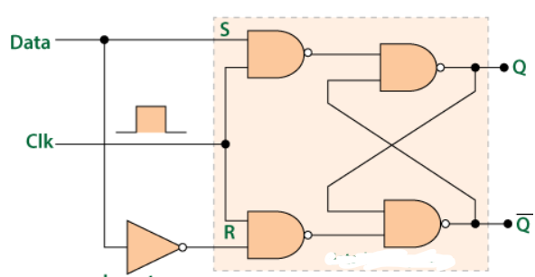
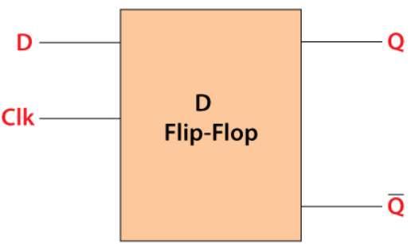
D Flip Flop
Step 1: Block Diagram
Step 2: Circuit diagram Diagram

Slide 12
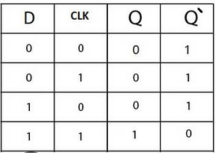
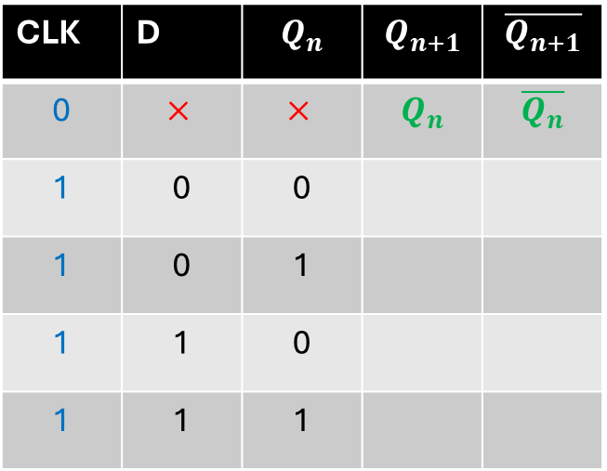
D Flip Flop
Step 3: Characteristics Table
Step 3: Truth Table
CLK | D | $$Q_{n}$$ | $$Q_{n+1}$$ | $$\overline{Q_{n+1}}$$
0 | $$×$$ | $$×$$ | $$Q_{n}$$ | $$\overline{Q_{n}}$$
1 | 0 | 0
1 | 0 | 1
1 | 1 | 0
1 | 1 | 1

Slide 13
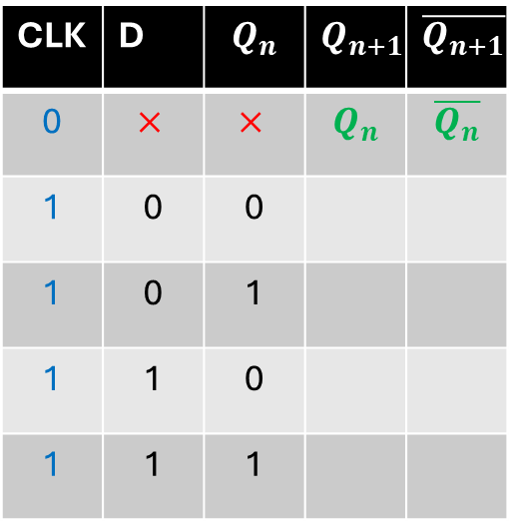
CLK | D | $$Q_{n}$$ | $$Q_{n+1}$$ | $$\overline{Q_{n+1}}$$
0 | $$×$$ | $$×$$ | $$Q_{n}$$ | $$\overline{Q_{n}}$$
1 | 0 | 0
1 | 0 | 1
1 | 1 | 0
1 | 1 | 1
Case1: D=0
Case2:
D=1

Slide 14
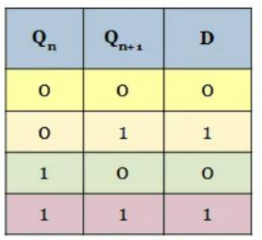
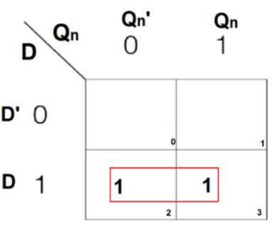
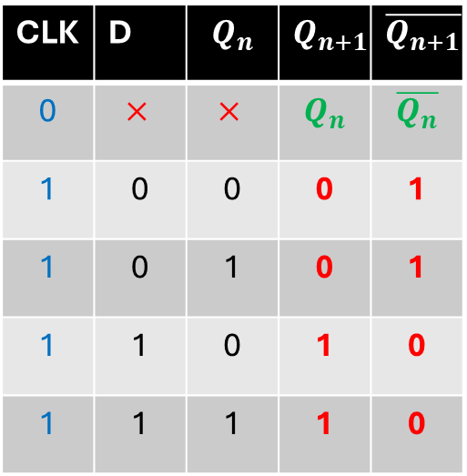
Step 5: Excitation Table
Step 4: Characteristics Table
CLK | D | $$Q_{n}$$ | $$Q_{n+1}$$ | $$\overline{Q_{n+1}}$$
0 | $$×$$ | $$×$$ | $$Q_{n}$$ | $$\overline{Q_{n}}$$
1 | 0 | 0 | 0 | 1
1 | 0 | 1 | 0 | 1
1 | 1 | 0 | 1 | 0
1 | 1 | 1 | 1 | 0
Step 6: Characteristics Equation
Qn+1= D

Slide 15
QUICK QUIZ (POLL)
The D Flip-Flop eliminates which problem found in the SR Flip-Flop? A) Toggle condition B) Indeterminate state C) High power consumption D) Clock dependency

Slide 16
QUICK QUIZ (POLL)
What happens to the output (Q) of a D Flip-Flop when the clock pulse is applied? A) Q toggles B) Q retains its state C) Q follows the input D D) Q becomes 0

Slide 17
D Flip flop problem
1. Data overwriting when present state is required
How to overcome these problems… Think About this

